Slide 1

Financial Impact on US House of Representatives Elections
Sanjana Venkat, Jasper MacNaughton, Paul Ciaccia III
Math 318

Slide 2
Introduction

Slide 3

Campaign Financing
Campaigns are financed through contributions and loans
Majority of funding is from individual donors
Does campaign funding play a role in election outcome?

Slide 4

FEC Data Set
Our data is from the 2016 Election
All 435 House seats are up for election every two years
The data set has 51 variables
We chose to pull information regarding campaign contributions, loans, expenditures, incumbency status, and outcome

Slide 5
Summary Statistics and Dataset Visualization

Slide 6
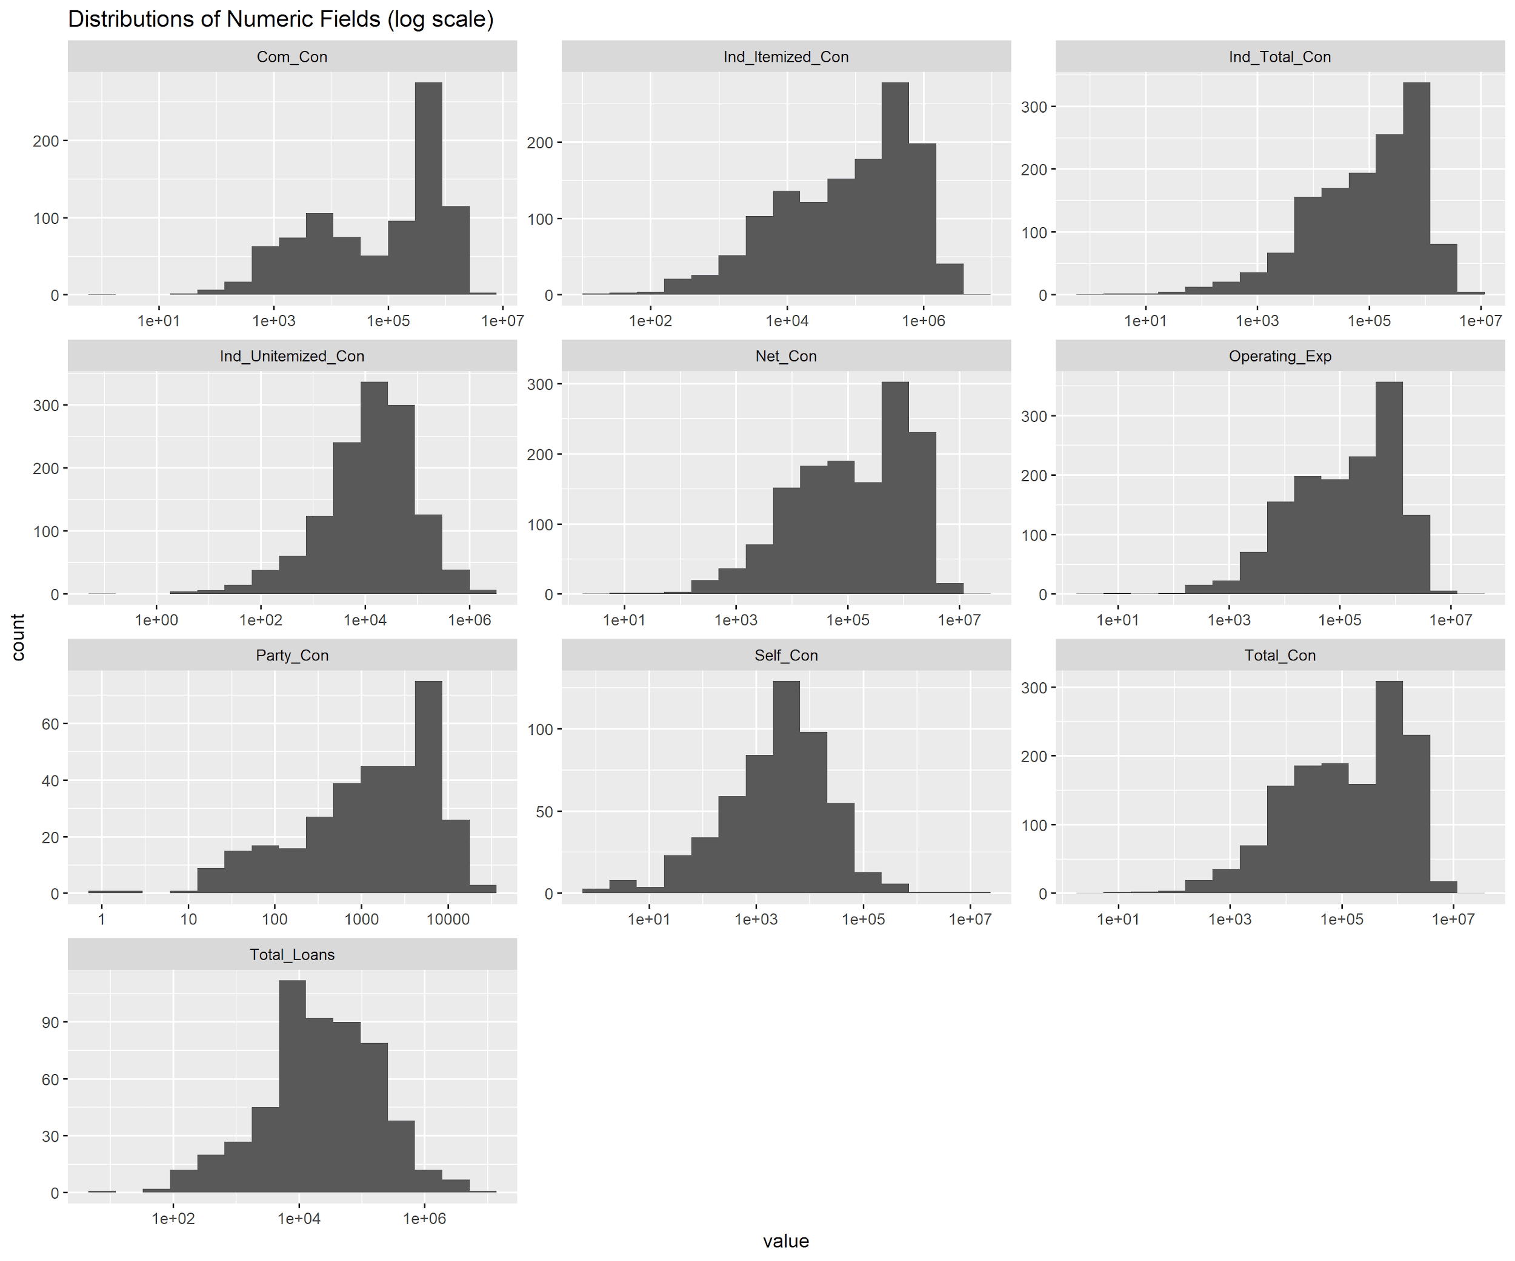
Histograms
Deceiving graph
Long right tail (log scale)
Exponential relationship shows wide range of values

Slide 7
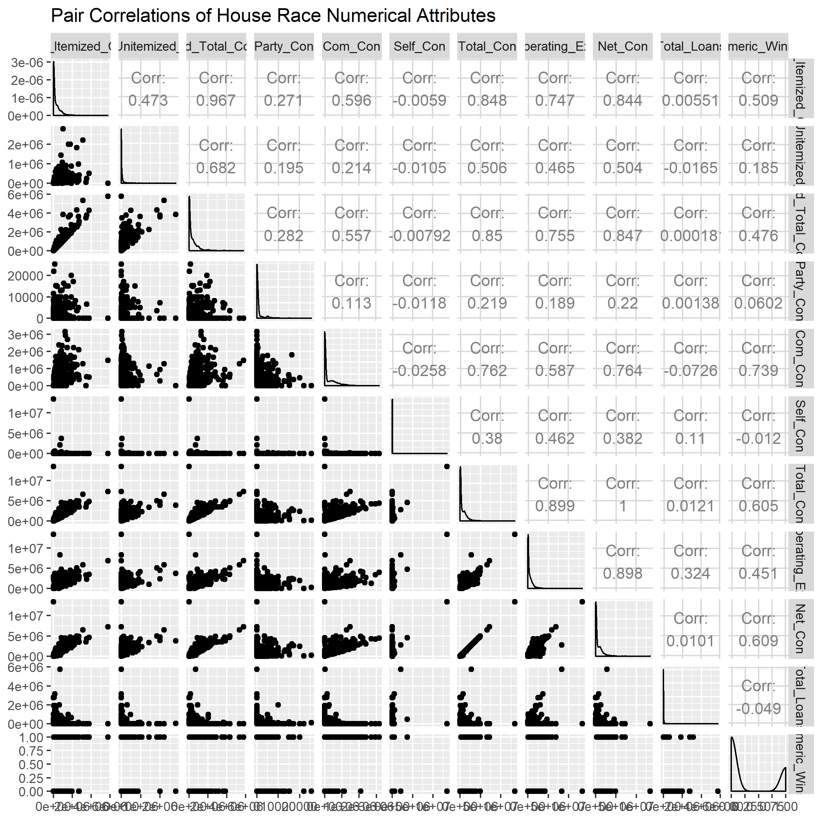
Pairwise Correlations
Many of the correlations were obvious such as individual itemized contributions and total individual contributions
Essentially all variables positively correlated with wins
Very strong correlation between operating expenditures and net contributions
Autocorrelation issue

Slide 8
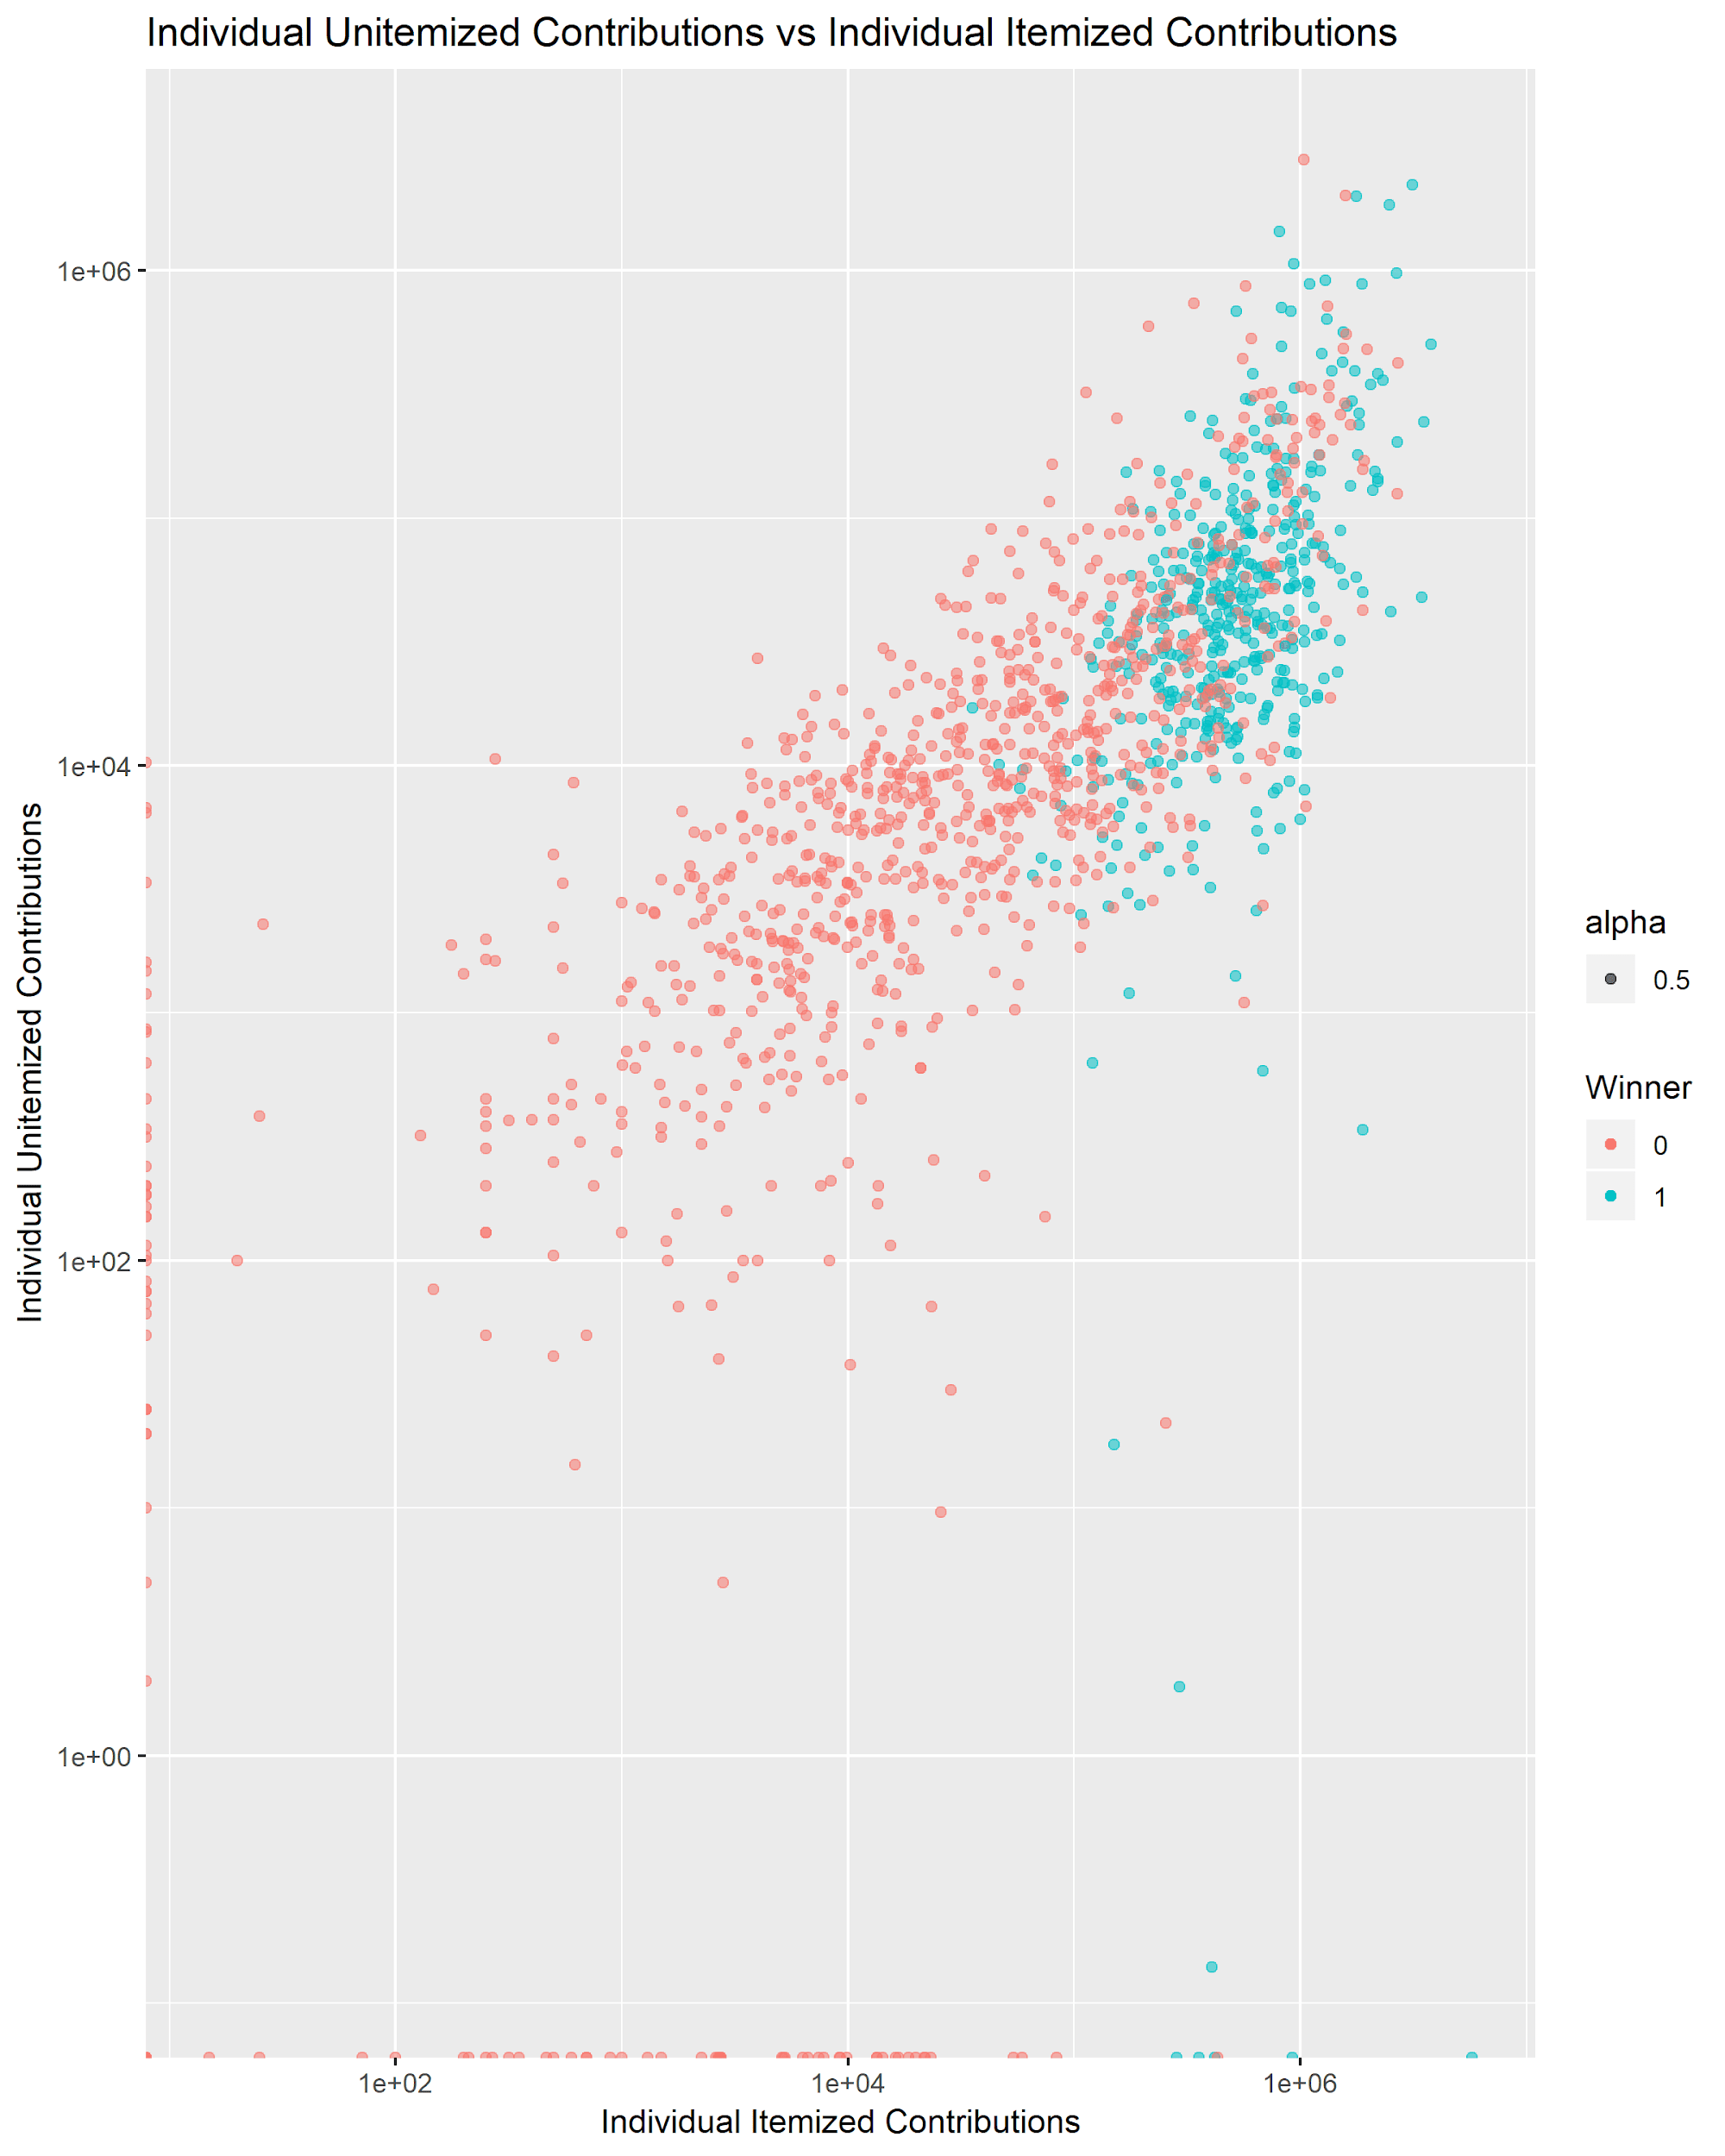
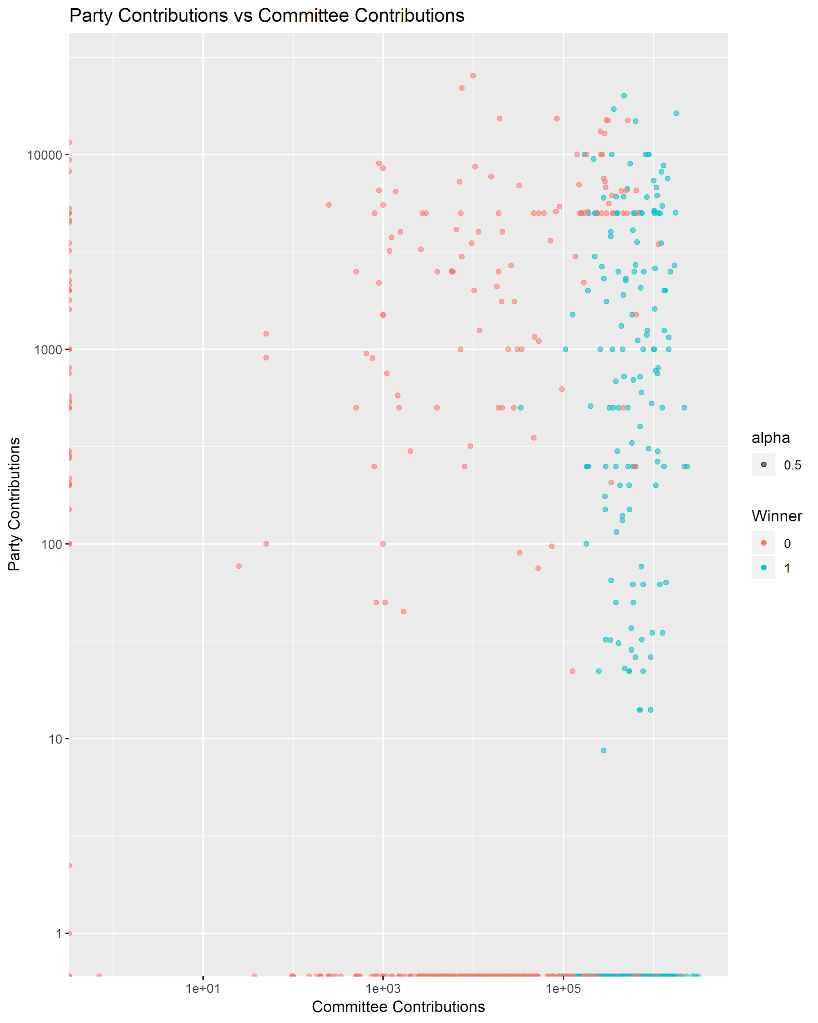
Scatterplots
Exponential trend for winners
Party contributions have little effect on outcome (but lot of zeros)
Committee contributions have strong positive correlation with winning

Slide 9
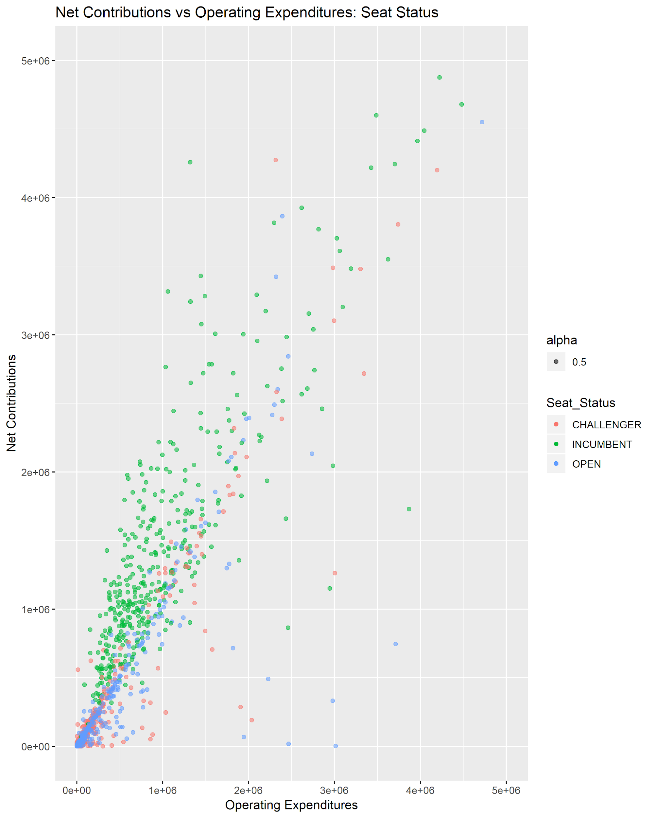
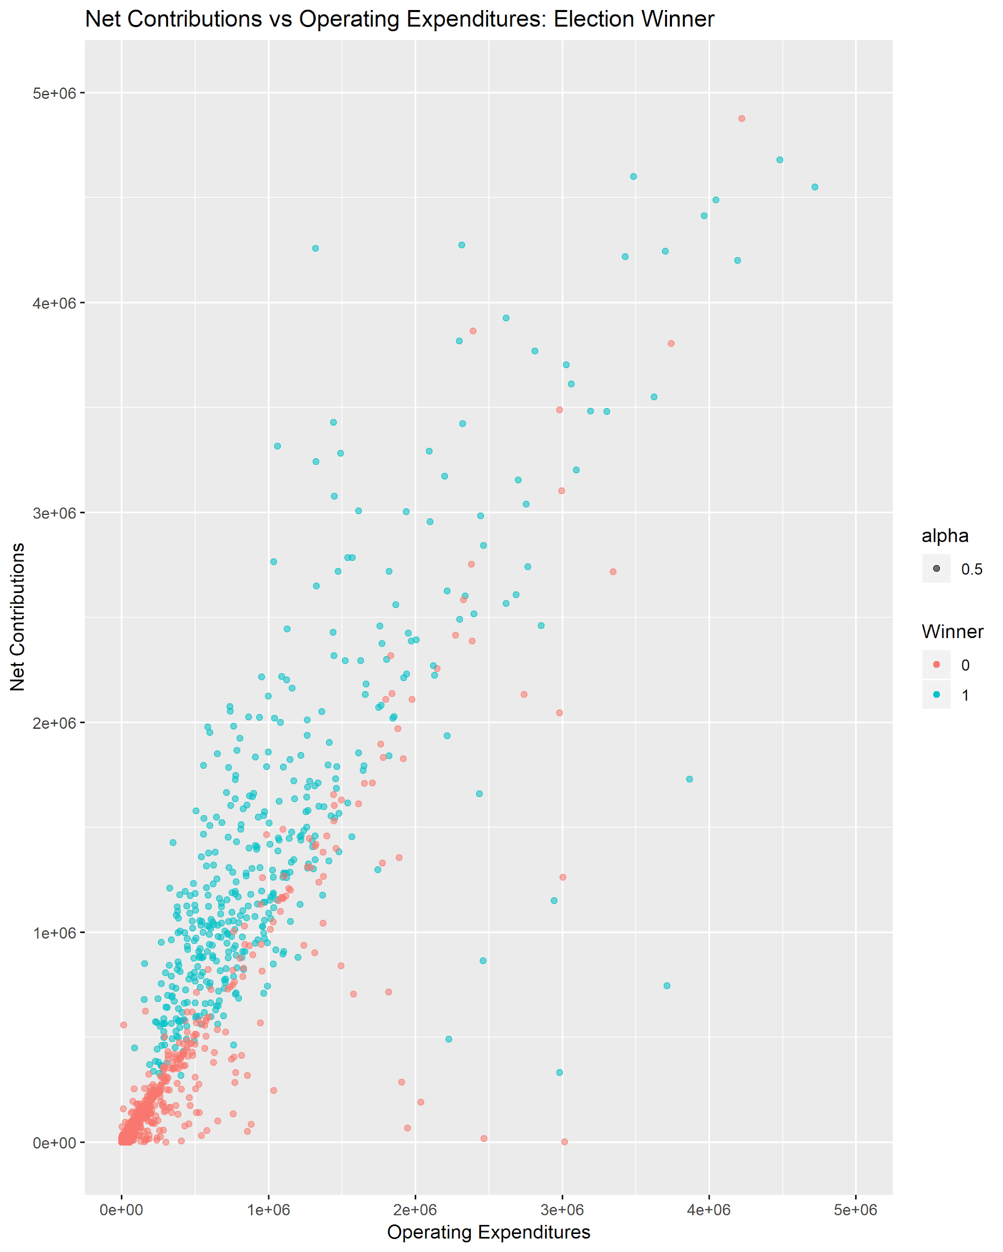
Scatterplots:
Graphed Net Contributions vs Operating expenditures with coloring based on seat status and election outcome.
Winners and incumbents trend the same, while losers trend with challengers and open

Slide 10
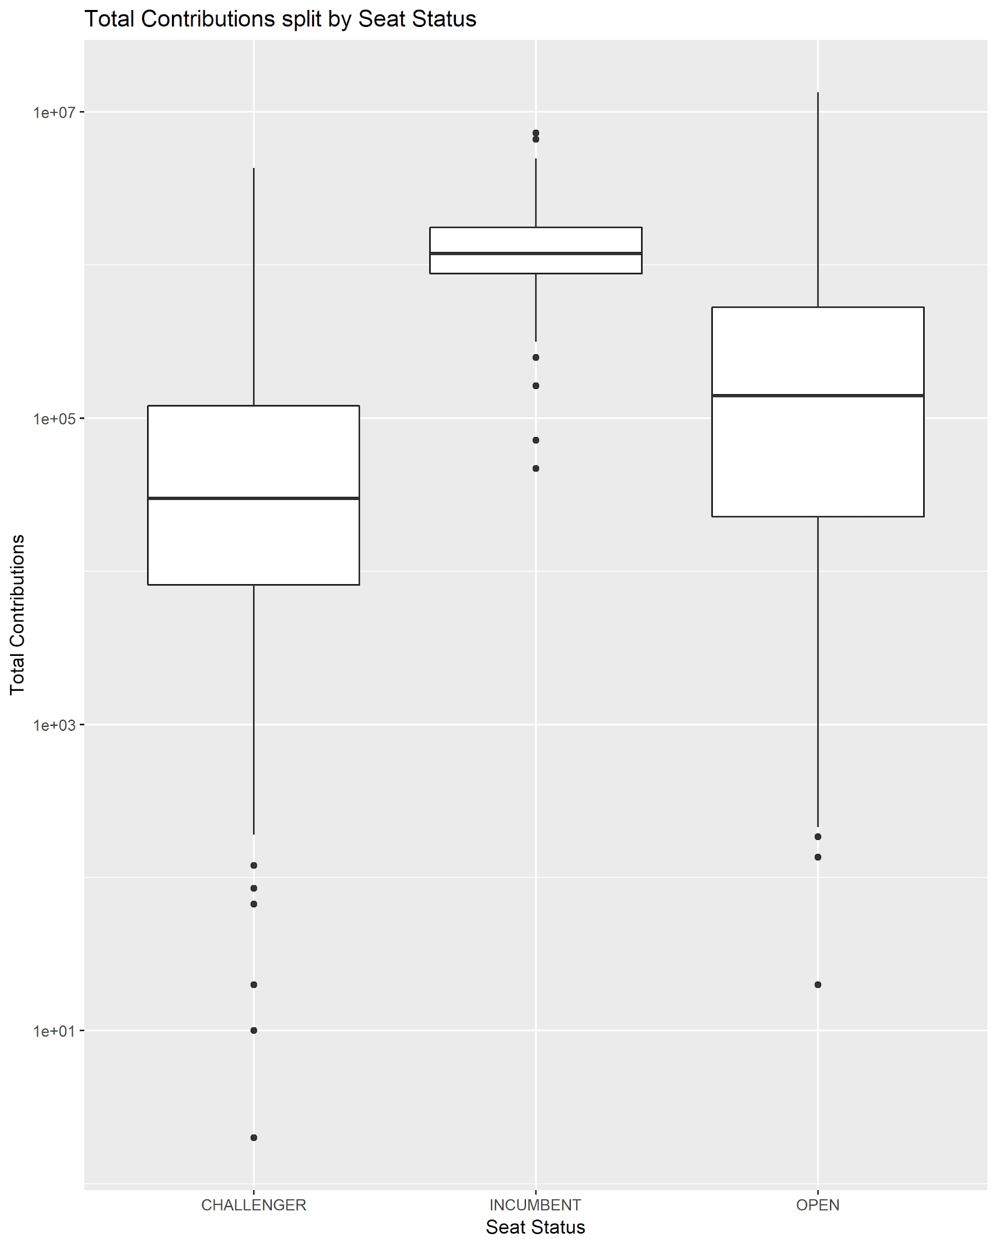
Box Plots:
Plotted funding based on seat status
Incumbents receive much more funding than challengers

Slide 11
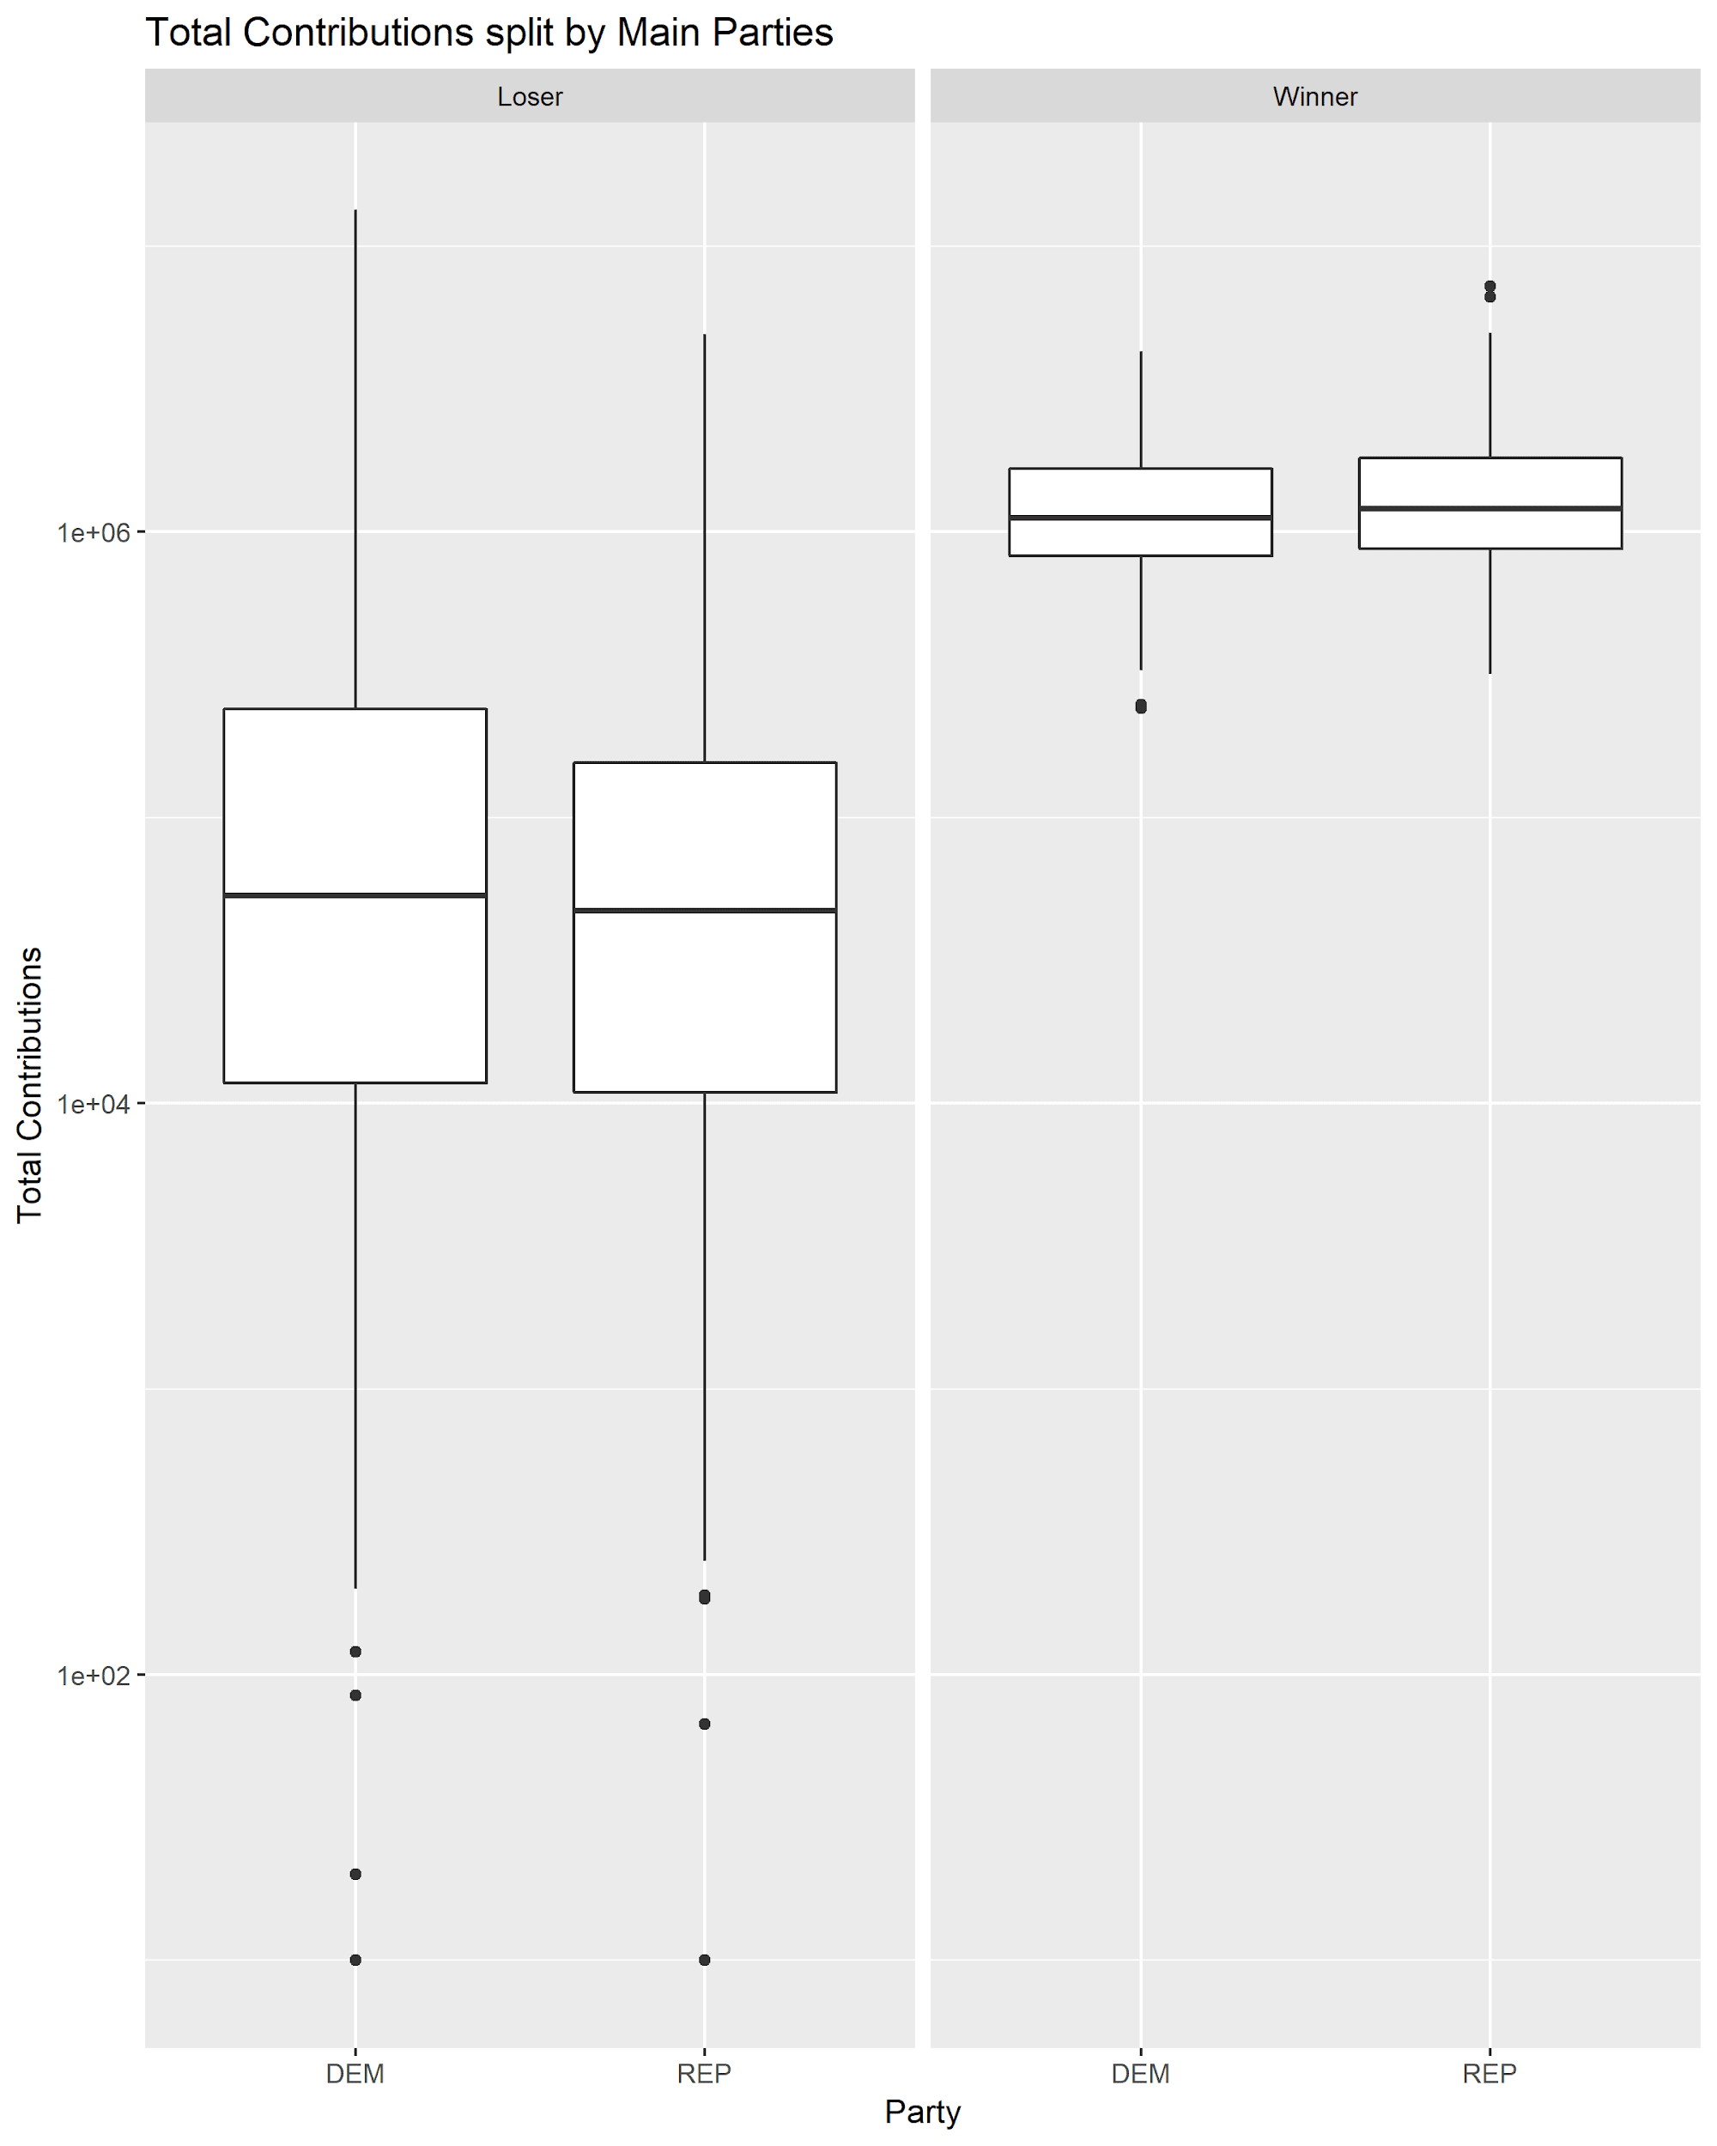
Box Plots:
Plotted funding by political affiliation
Not much difference between the two parties

Slide 12
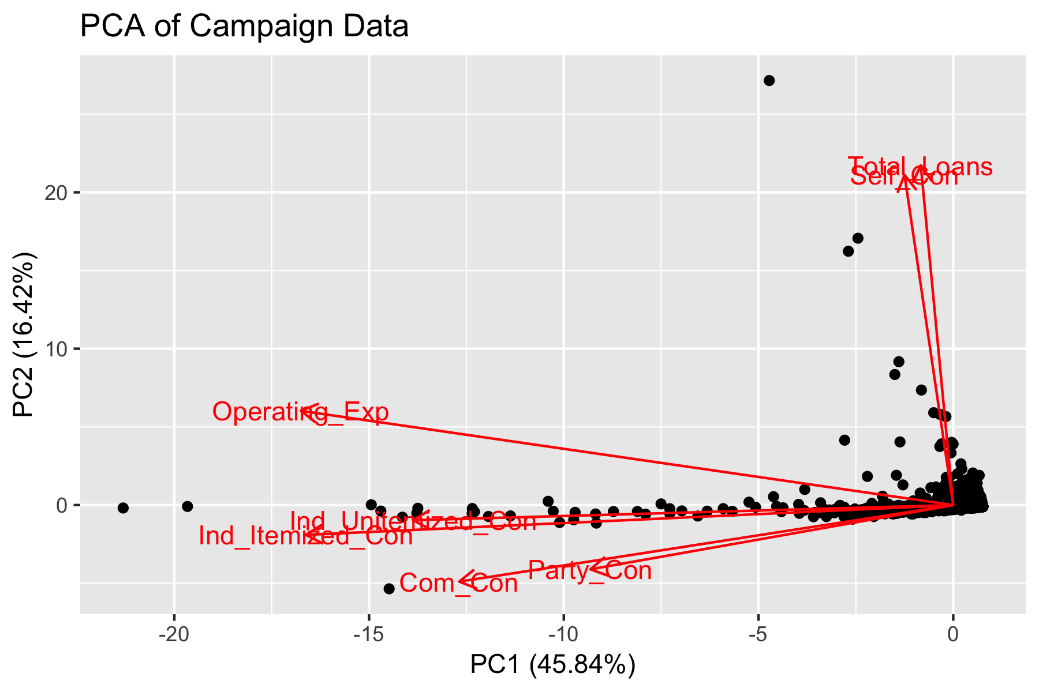
Advanced Summary Stats: PCA
Exponential data makes PCA assumption of linearity fail
We do not move forward with clustering

Slide 13
Predictive Modeling

Slide 14
Predictor Fields
Factors
Party (Dem, Rep, Other)
Seat Status (Incumbent, Open, Challenger)
Numeric
Itemized and Unitemized Individual Contributions
Party Contributions
Committee Contributions
Self Contributions
Operating Expenses
Net Contributions
Total Loans

Slide 15
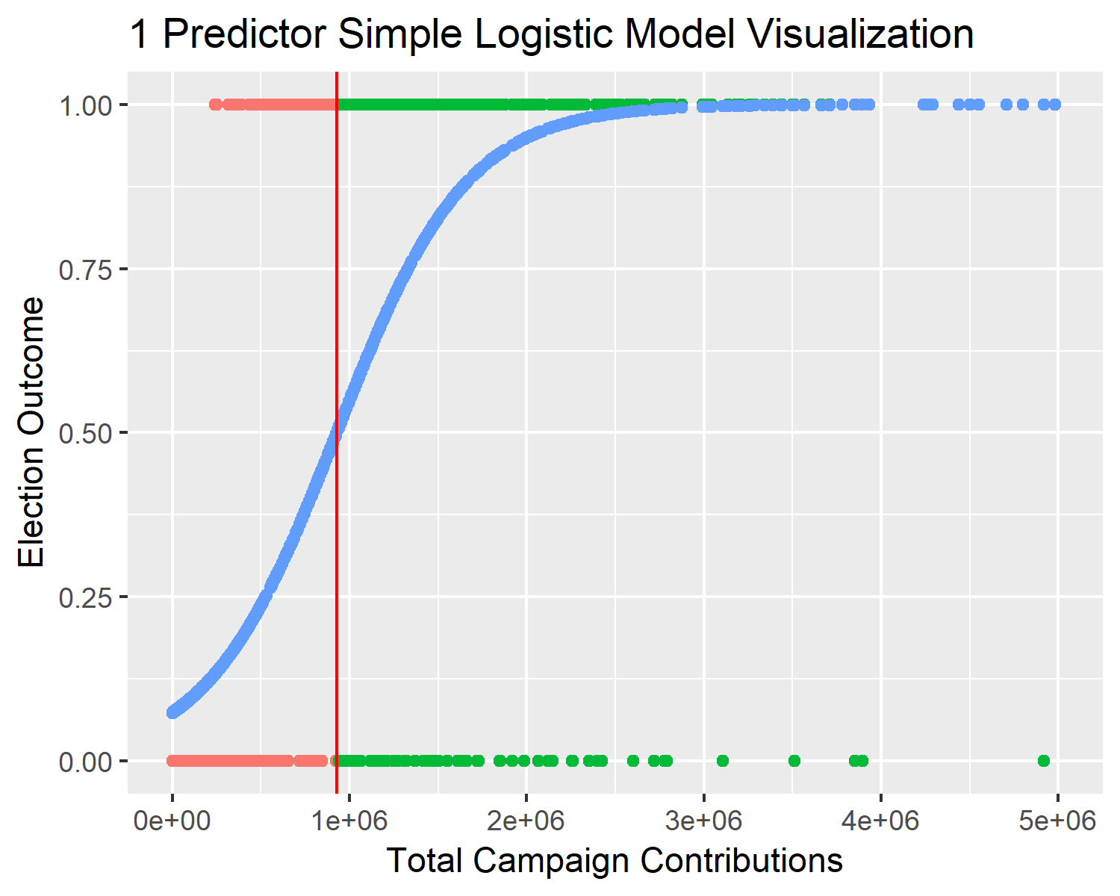
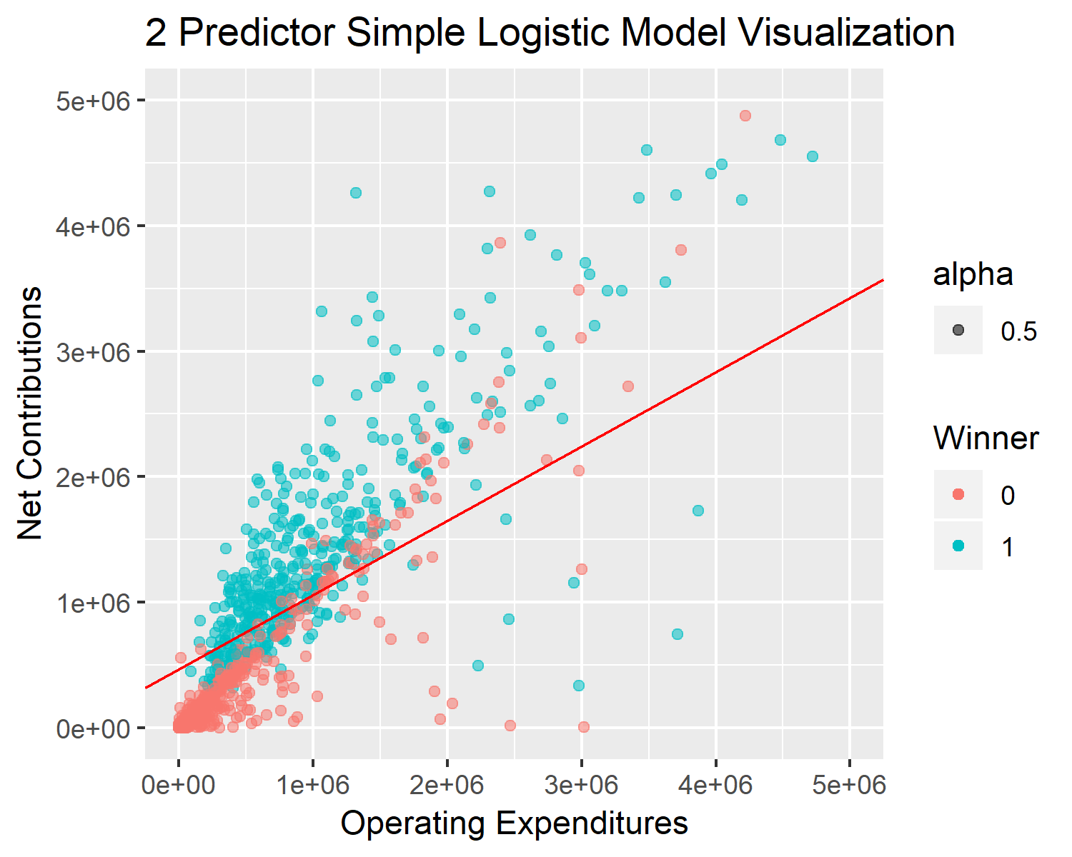
Basic Modeling: Logistic Regression
Testing Error: 14.2%
Testing Error: 11.4%

Slide 16
2 Predictor Logistic Regression Coefficients
Field | Coefficient Value
Intercept | -2.53
Net Contributions | 5.45 x 10^-06
Operating Expenditures | -3.22 x 10^-06
Autocorrelation!
Testing Error: 11.4%

Slide 17
Autocorrelation
The Statistics Answer:
“Ahh! Abort”
The Machine Learning Answer:
“Ehh, whatever”

Slide 18
10-Fold Cross Validation
Model | Estimated Misclassification Rate
Full Logistic | 4.76 %
LDA | 5.04 %
QDA | 5.67 %
KNN k=3 | 4.55 %
KNN k=5 | 4.49 %
Linear SVM | 5.18 %
RBF SVM | 3.57 %

Slide 19
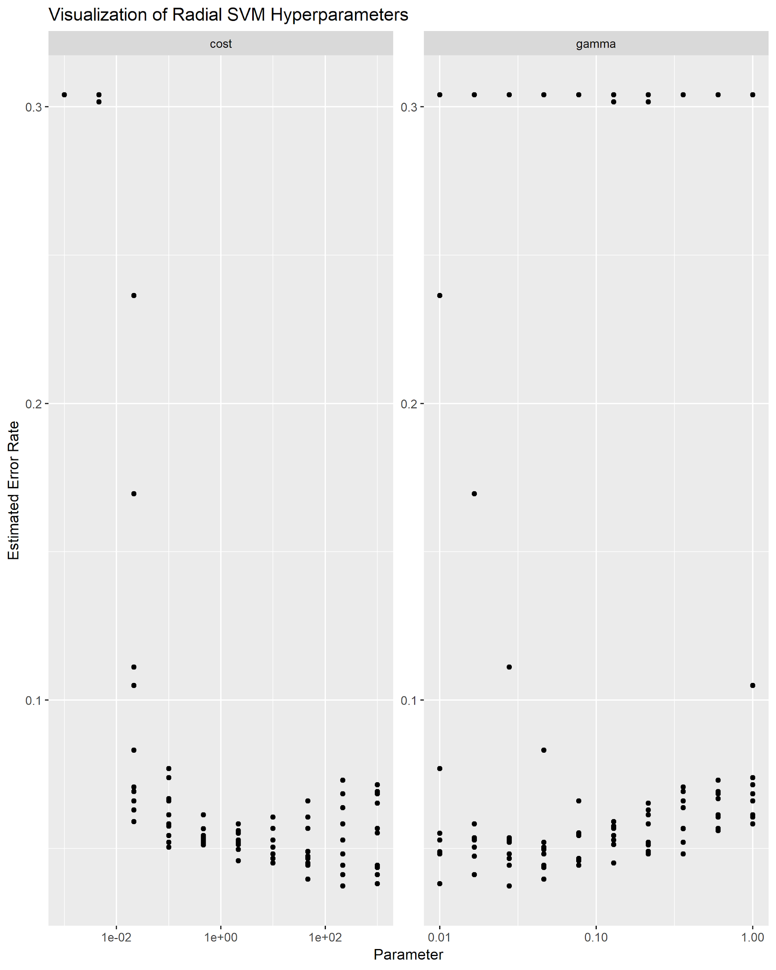
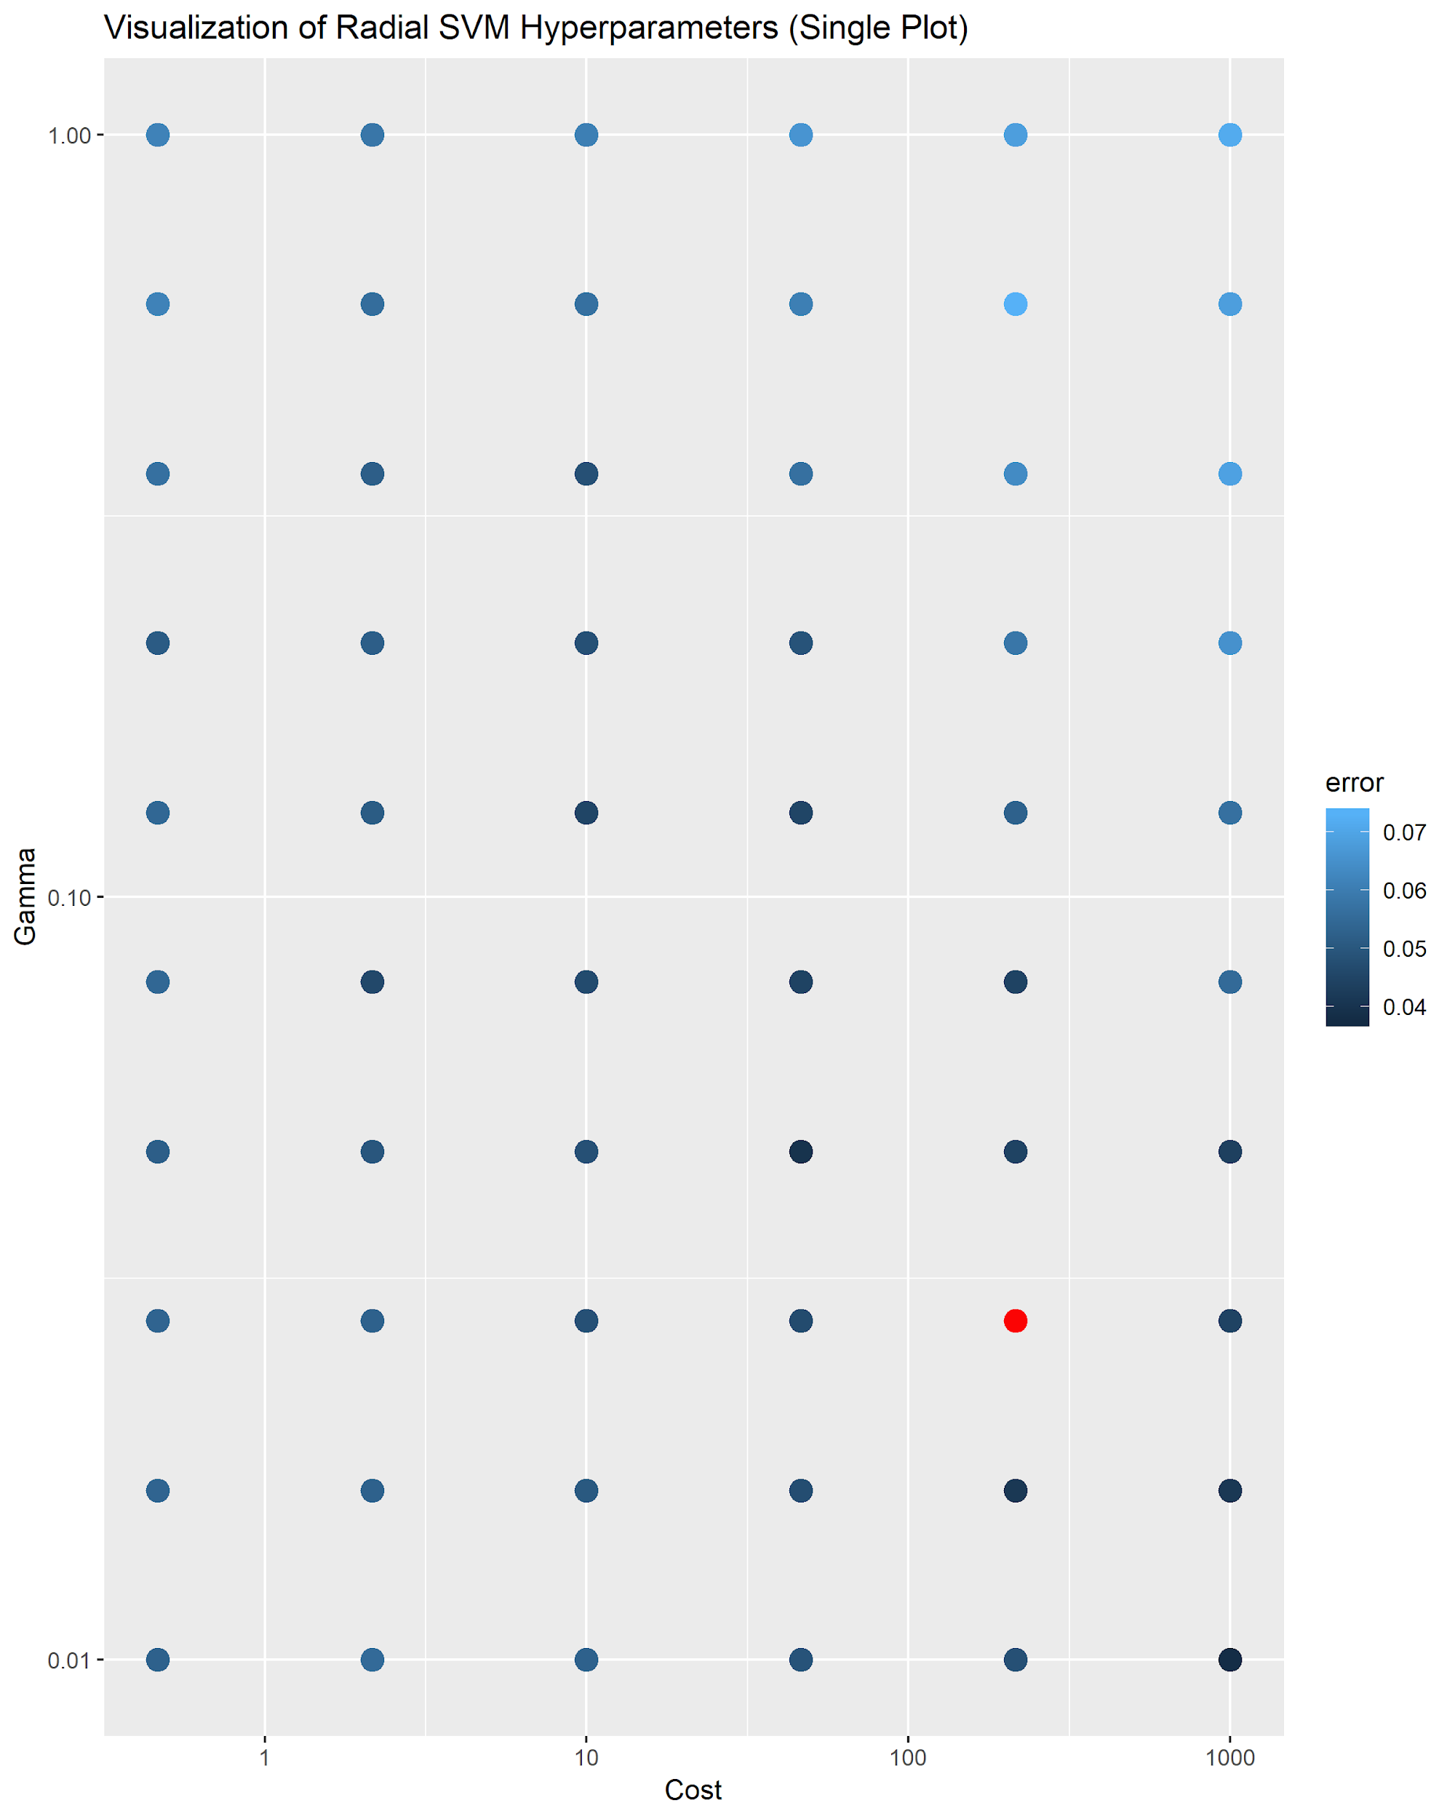
Moving Forward with RBF SVM - Hyperparameters
Tuning:
Cost: between 10 and 10,000
Gamma: between 0.001 and 0.1

Slide 20
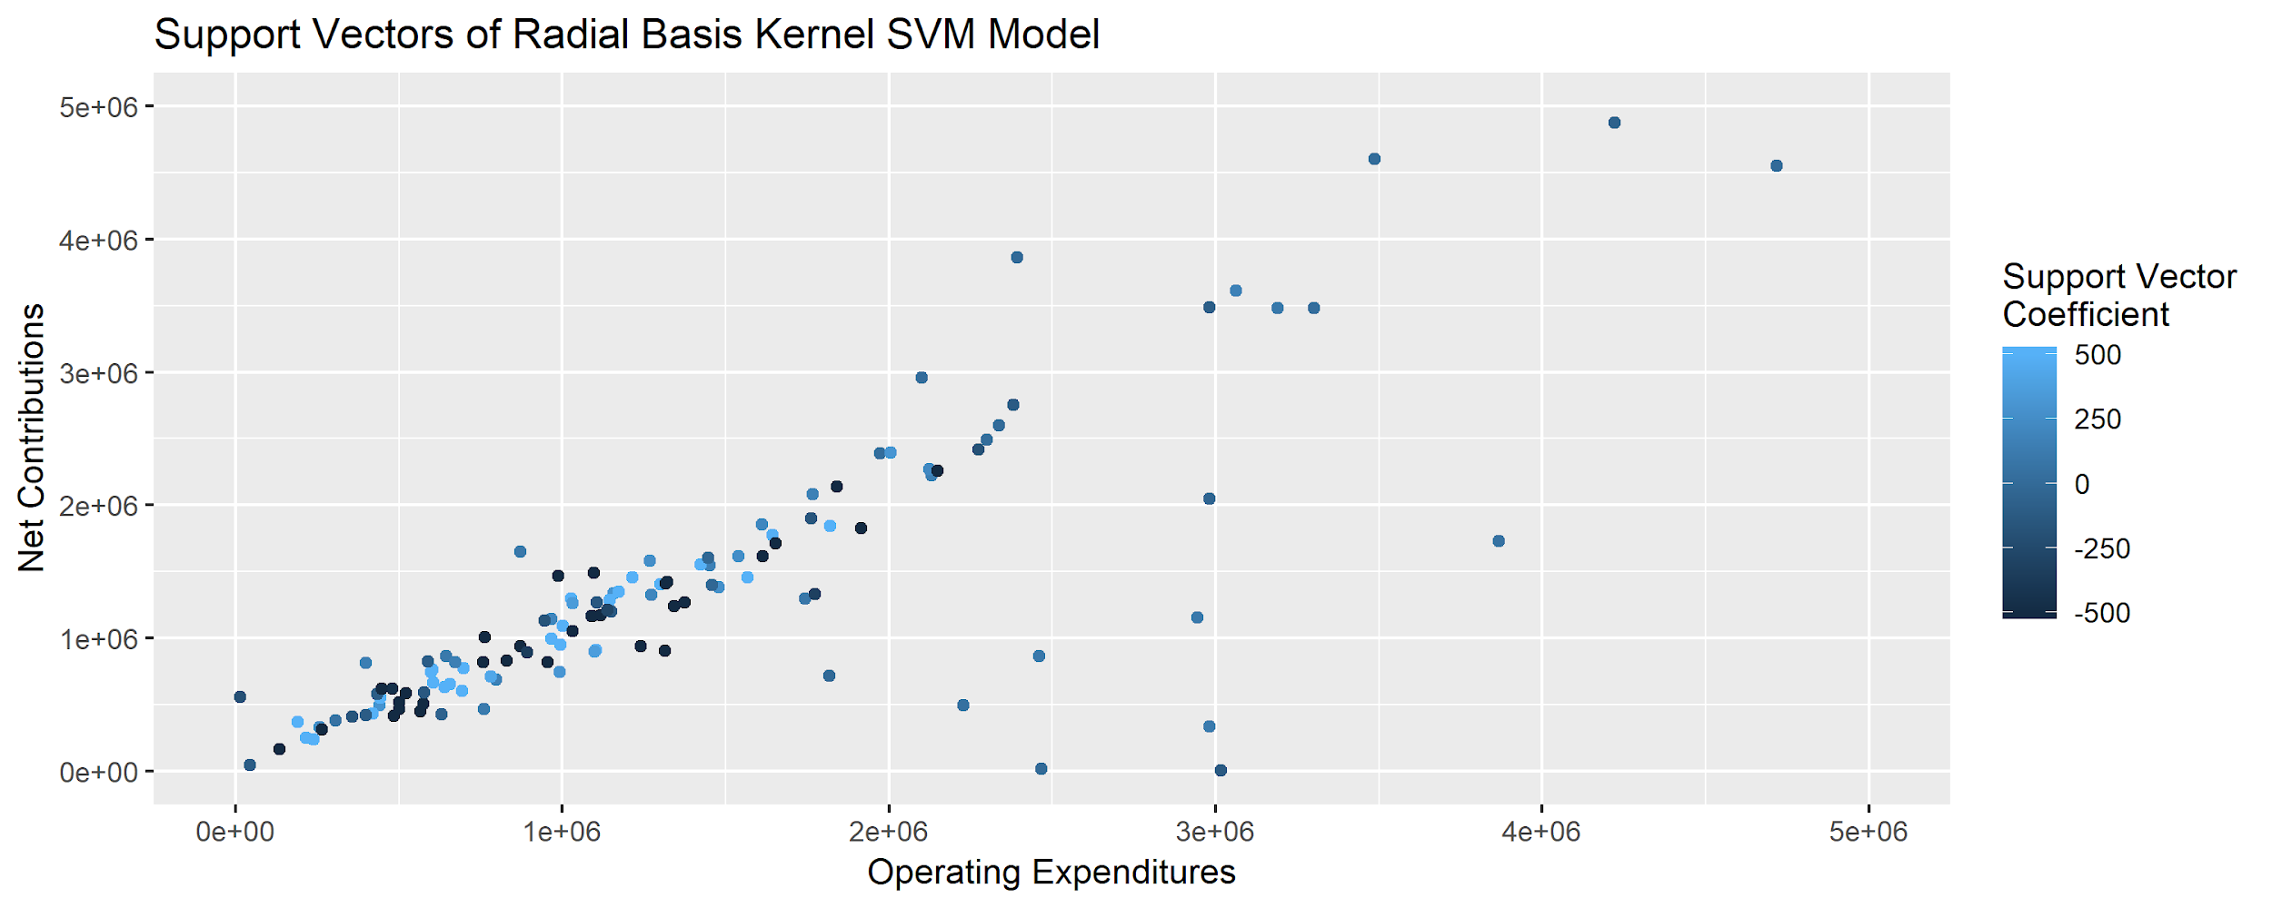
Visualizing the Support Vectors

Slide 21
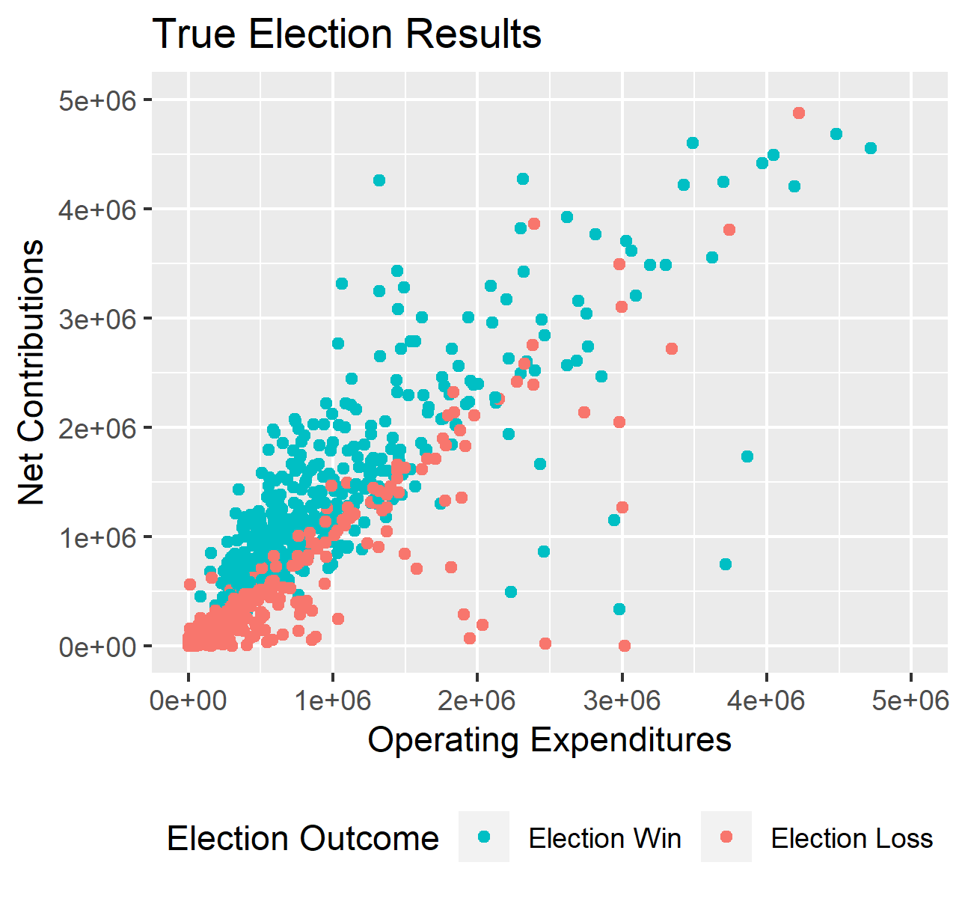
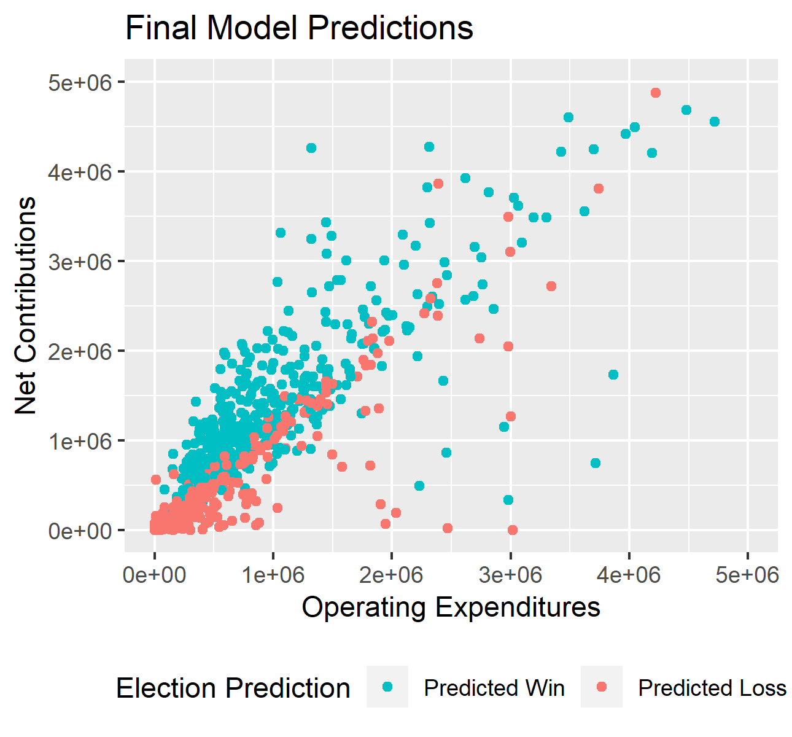
Election Results vs Final Model Predictions

Slide 22
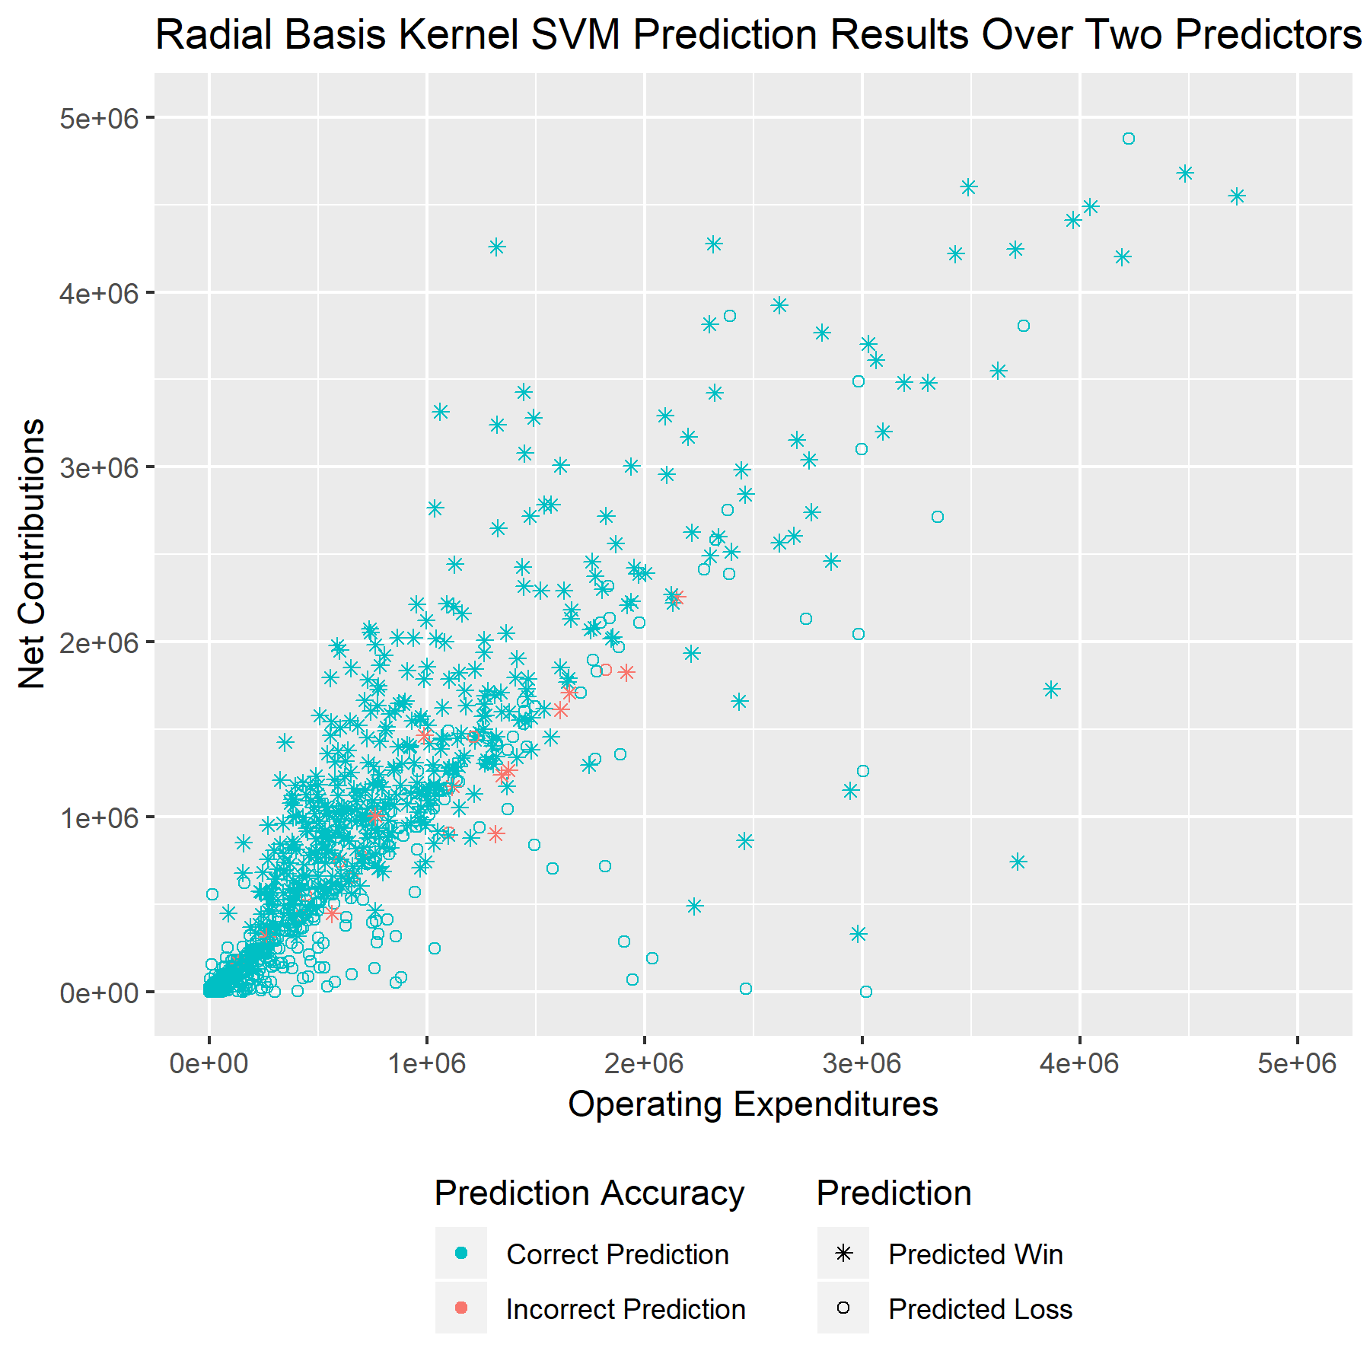
Model Results
1.54% Error Rate
127 support vectors
 | Predicted Loss | Predicted Win
Election Loss | 979 | 13
Election Win | 9 | 526

Slide 23
98.5%
2016 House elections were
explainable by campaign finance data.

Slide 24
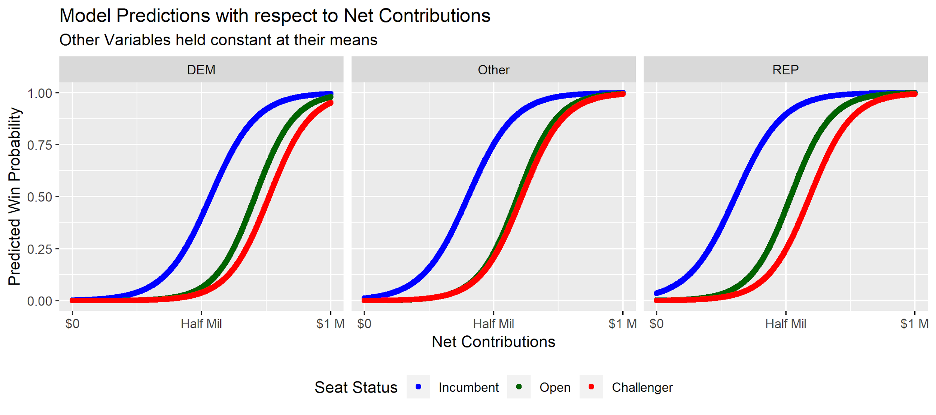
Predictions as a Function of Net Contributions (1/2)

Slide 25
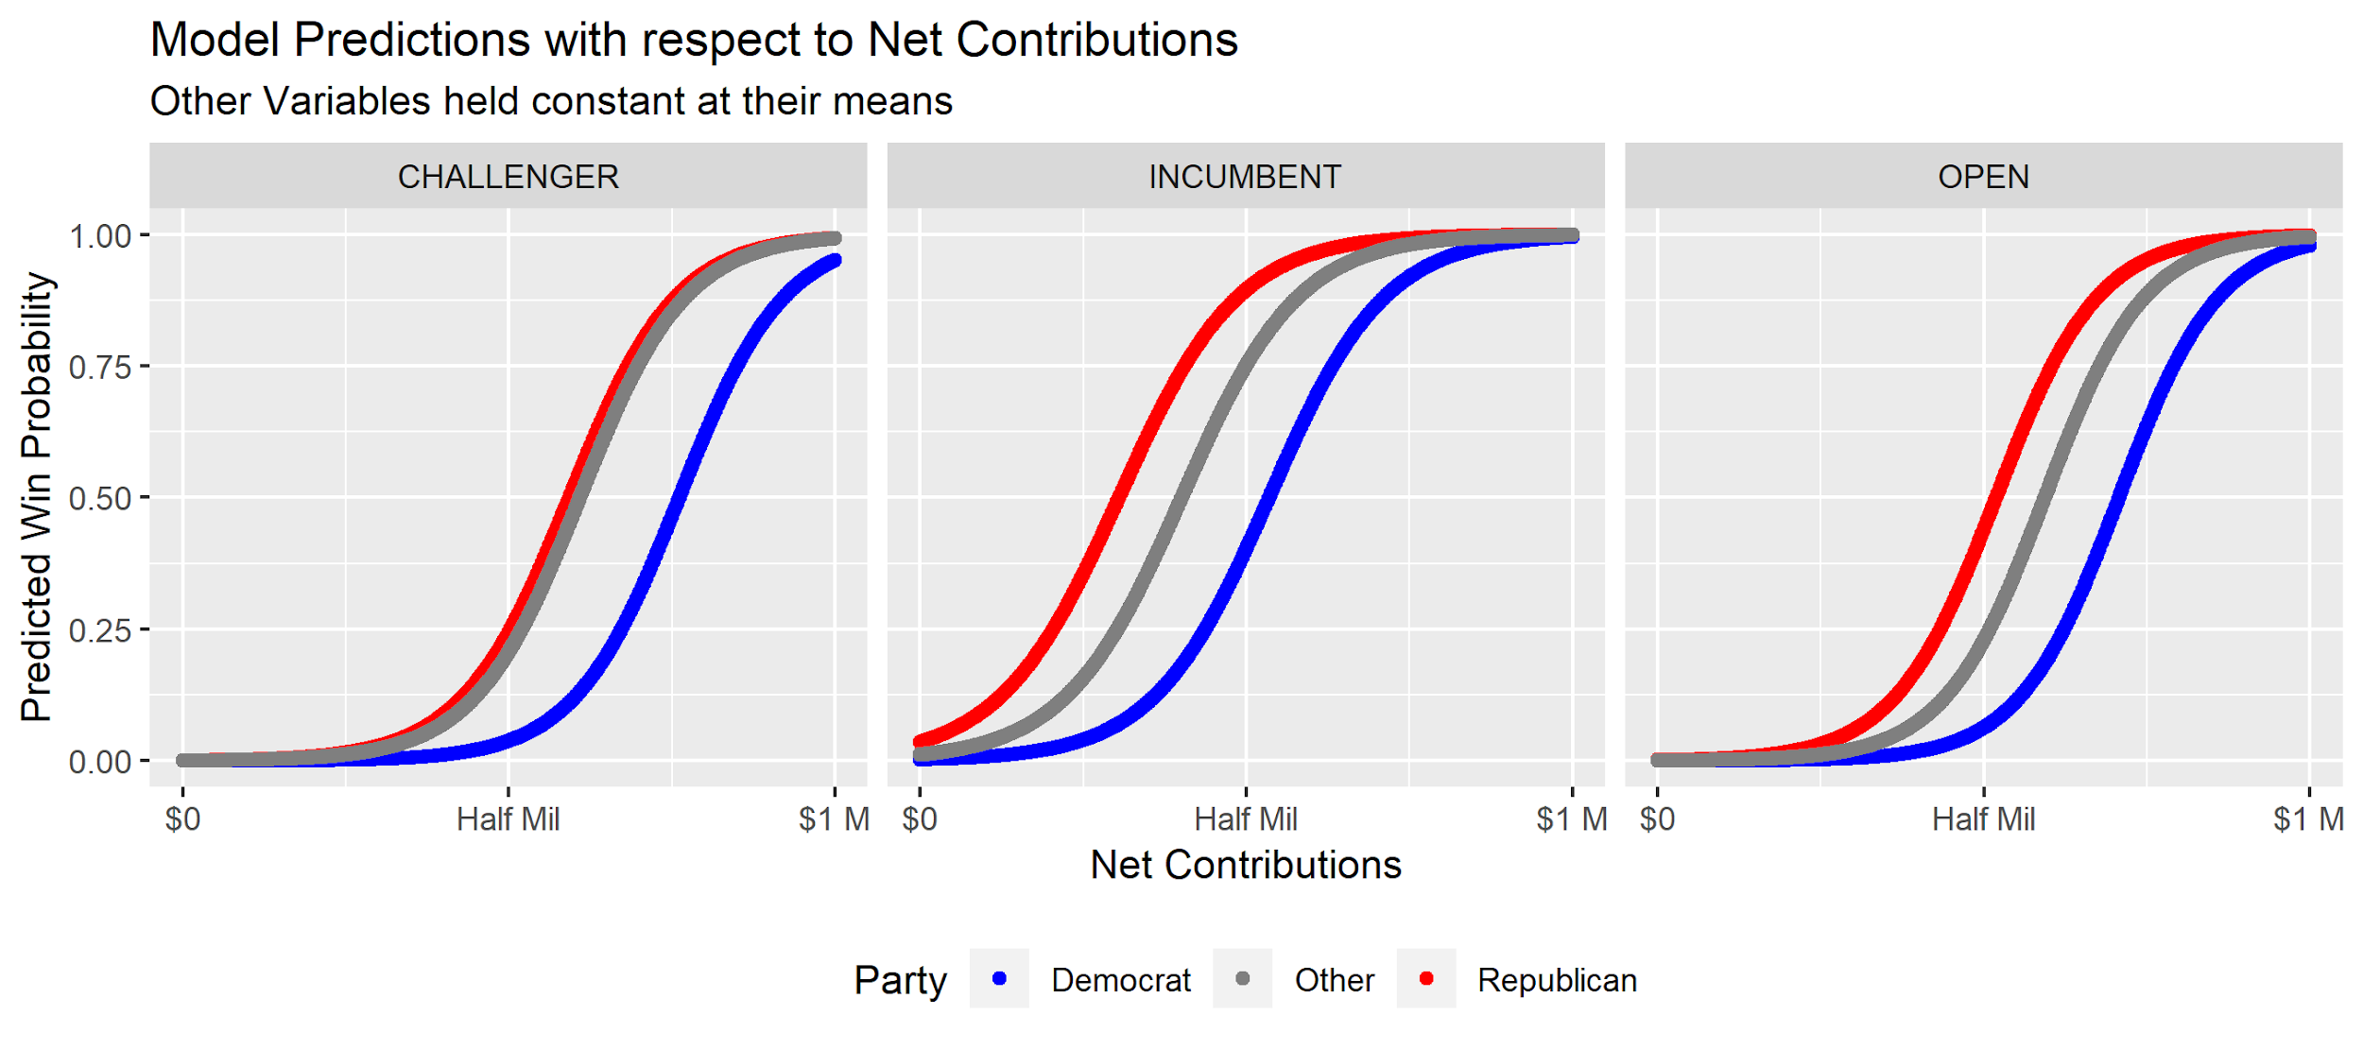
Predictions as a Function of Net Contributions (2/2)

Slide 26
Final Conclusions
2016 House elections are very predictable (98.5% prediction accuracy rate, just 22 of the 1,427 of candidates misclassified)
Incumbent candidates received much more funding than candidates running against an incumbent or for an open seat
Election winners received much more campaign contributions than losing candidates
Republicans and third party candidates appear to have an advantage at winning elections over democrats at similar levels of net contributions (all else held constant)
Go democracy

